Slide 1





Digital Project Monitoring
Jal Rekha
September 2025
Balkrishna Patidar
GIS Expert

Slide 2
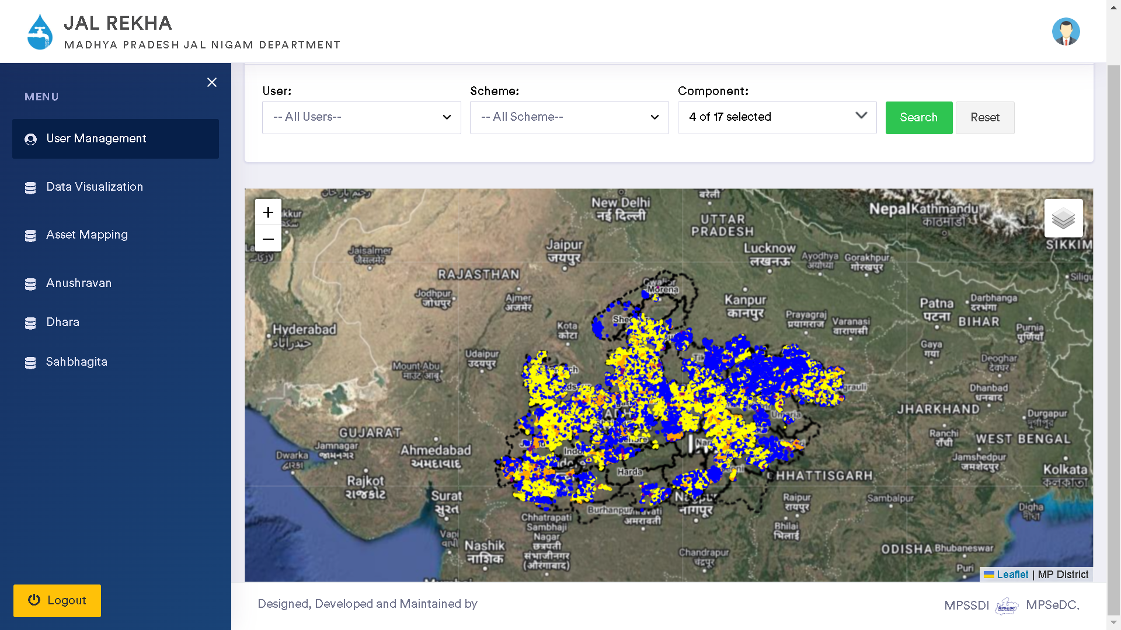
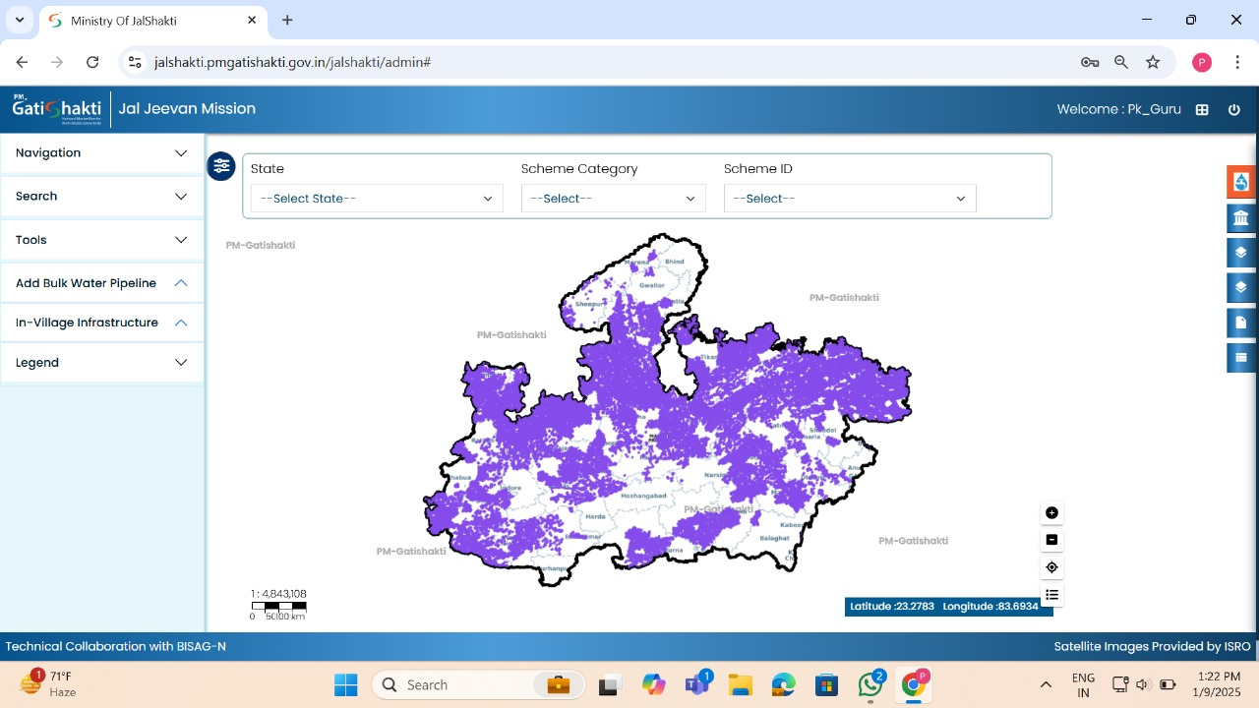
Digital Project Management - Jal Rekha
Jal Rekha is a GIS based mobile and web application for monitoring and management, digital record of progress of water supply projects across the state.
Details of mapped assets uploaded onto Jal Rekha portal are continuously shared with PM-Gatishakti portal through API.

Slide 3
Benefits from Jal Rekha
Accurate Asset Tracking : Real time location tracking of assets and comparison with approved designs.
Streamline Quality Assurance: Reduce time consumption in inspection procedures and improved work quality through categorized inspections.
Improved Decision Making : Access to past inspection reports and data driven insights.
Enhanced Collaboration : Ensuring that any other department shall have complete and accurate GIS-based location of MPJN pipe line networks. It has become easier for MPJN to plan the pipeline network and get clearances from respective departments quickly. It will also be easier for other departments to plan their works accordingly, include provision for utility shifting if necessary and execute their work without accidentally damaging existing MPJN infrastructure.

Slide 4
Digital Project Monitoring – Jal Rekha
1. Execution
Jal Rekha
Asset Mapping
2. O&M
Dhara
Anushravan
Jal Rekha
Nirmal
Sopan
Jal Samadhan
Sahbhagita

Slide 5
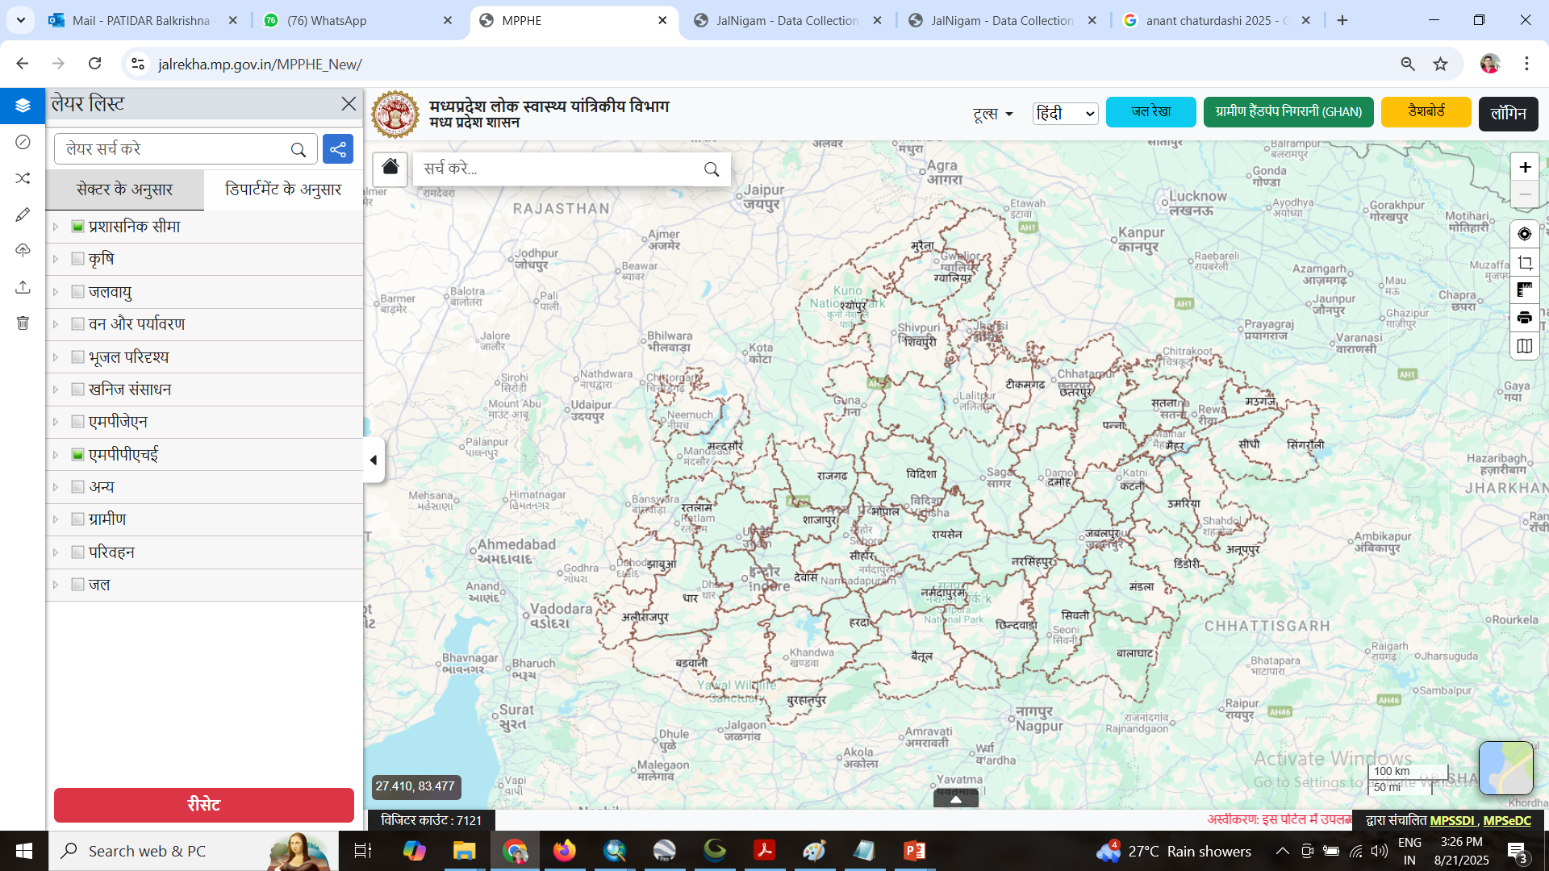
MPPHE Geoportal
https://jalrekha.mp.gov.in/MPPHE_New/

Slide 6
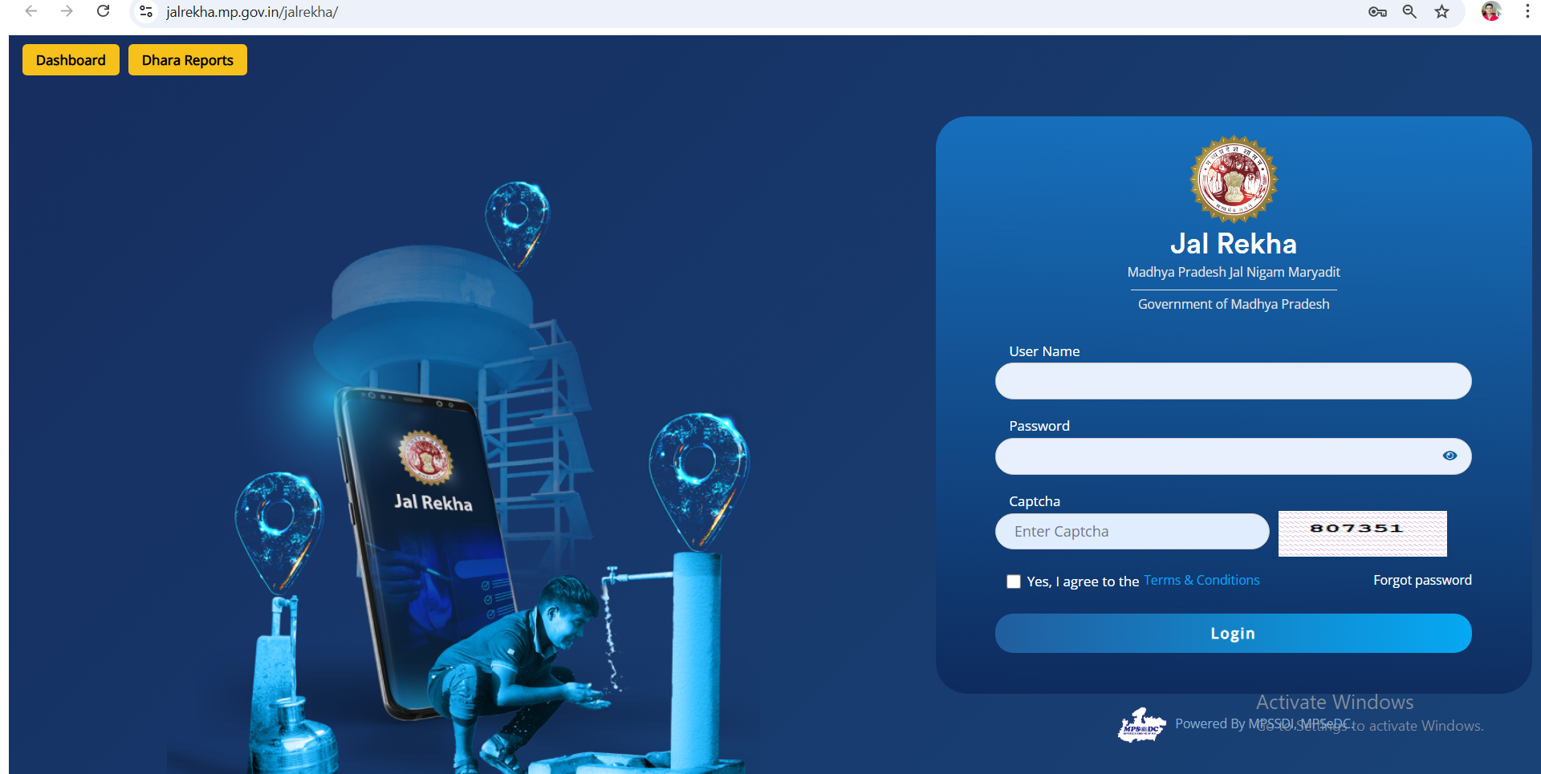
Jal Rekha Portal
https://jalrekha.mp.gov.in/jalrekha/

Slide 7
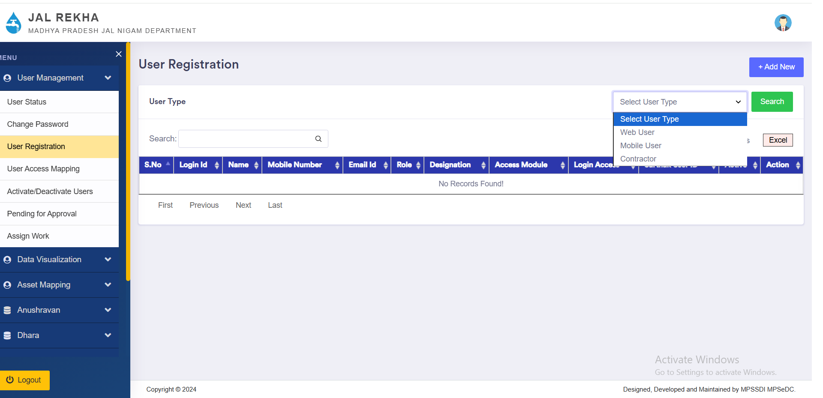
User Management

Slide 8
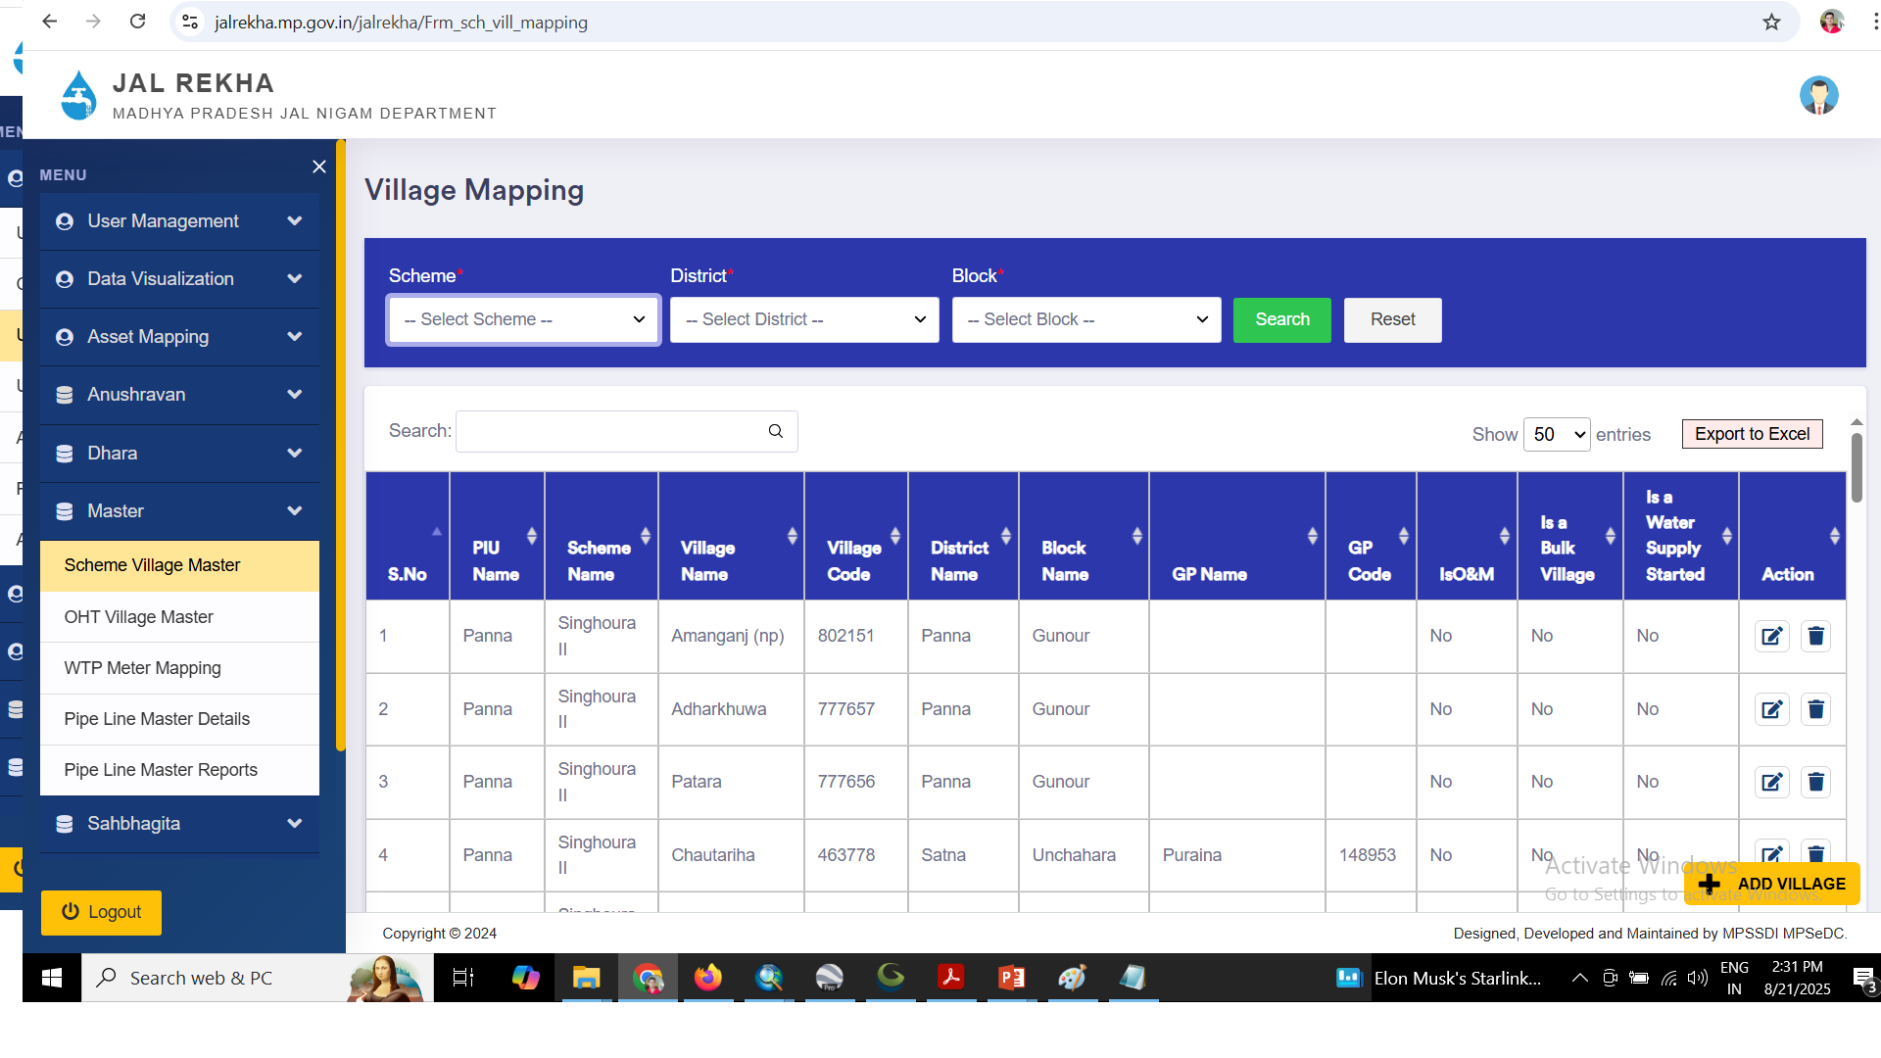
Scheme Village Master

Slide 9
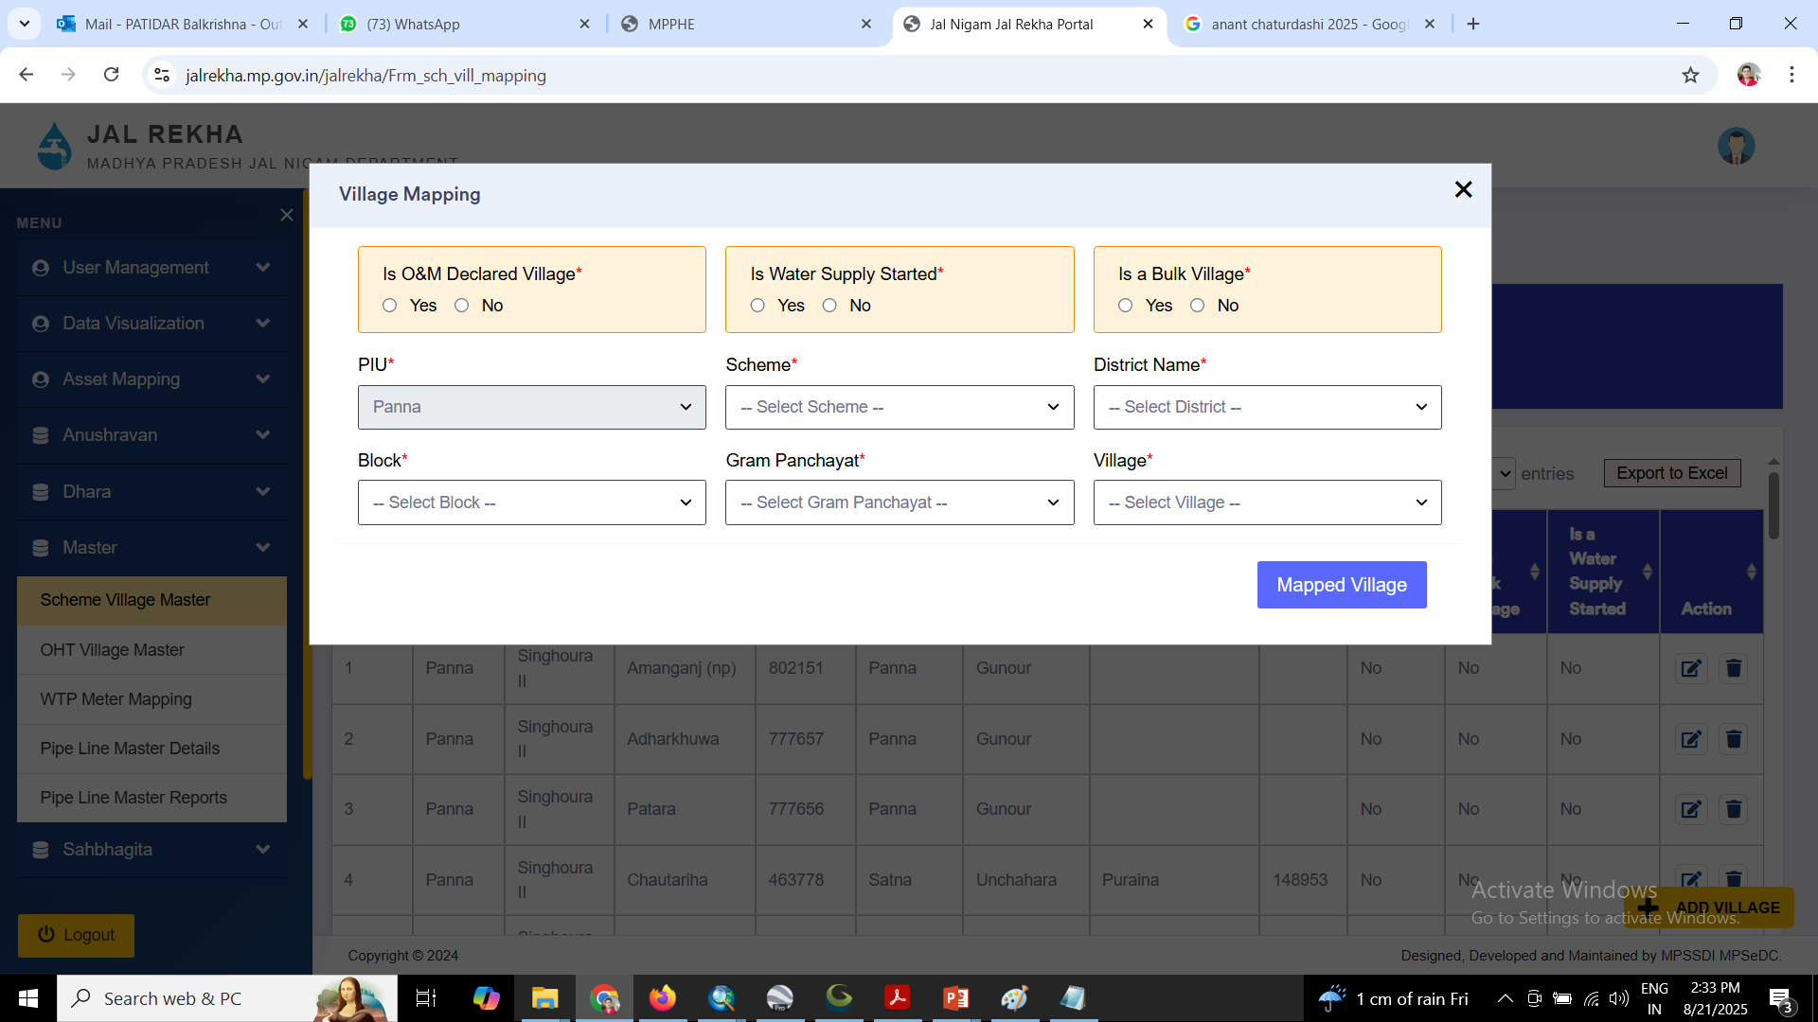

Slide 10
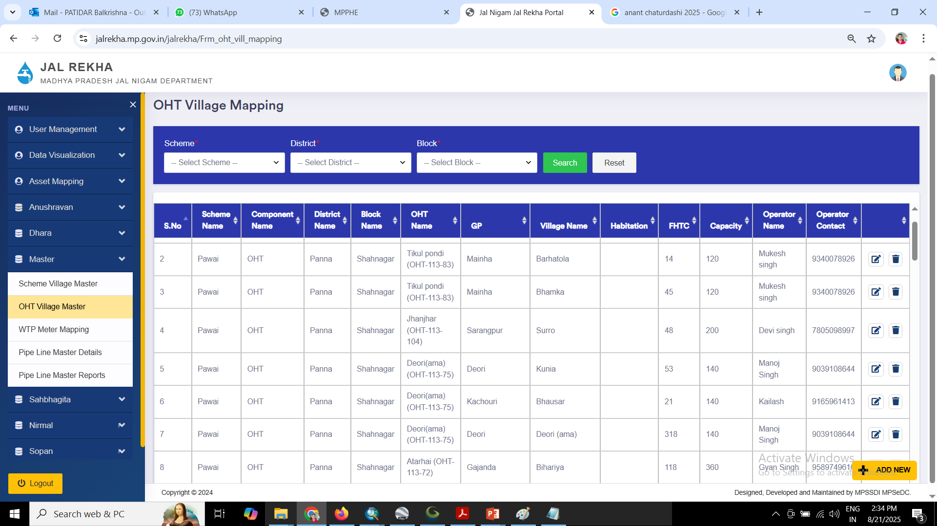
OHT Village Master

Slide 11
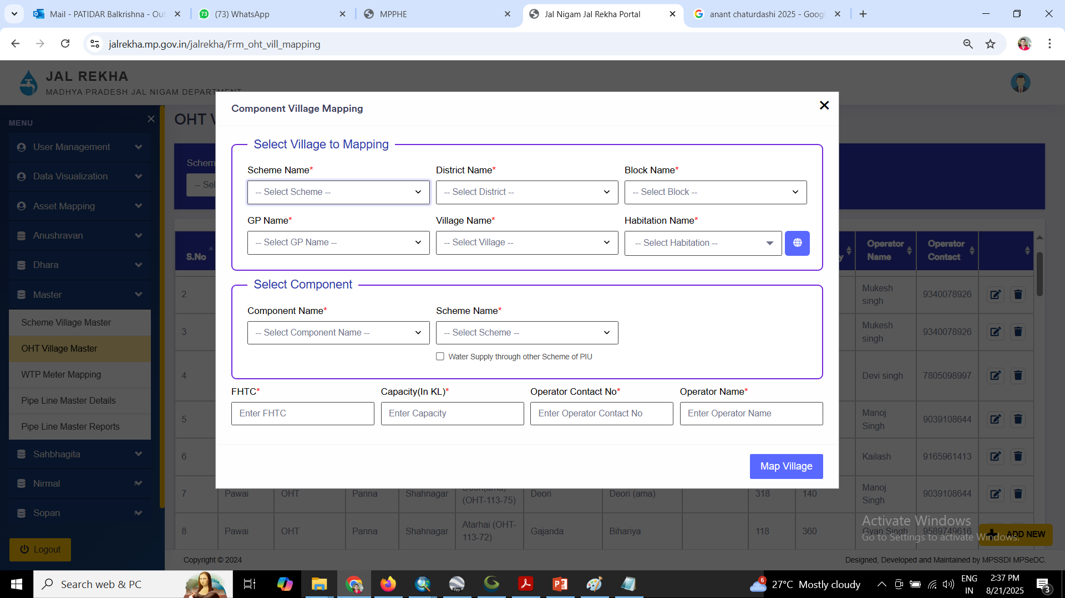

Slide 12
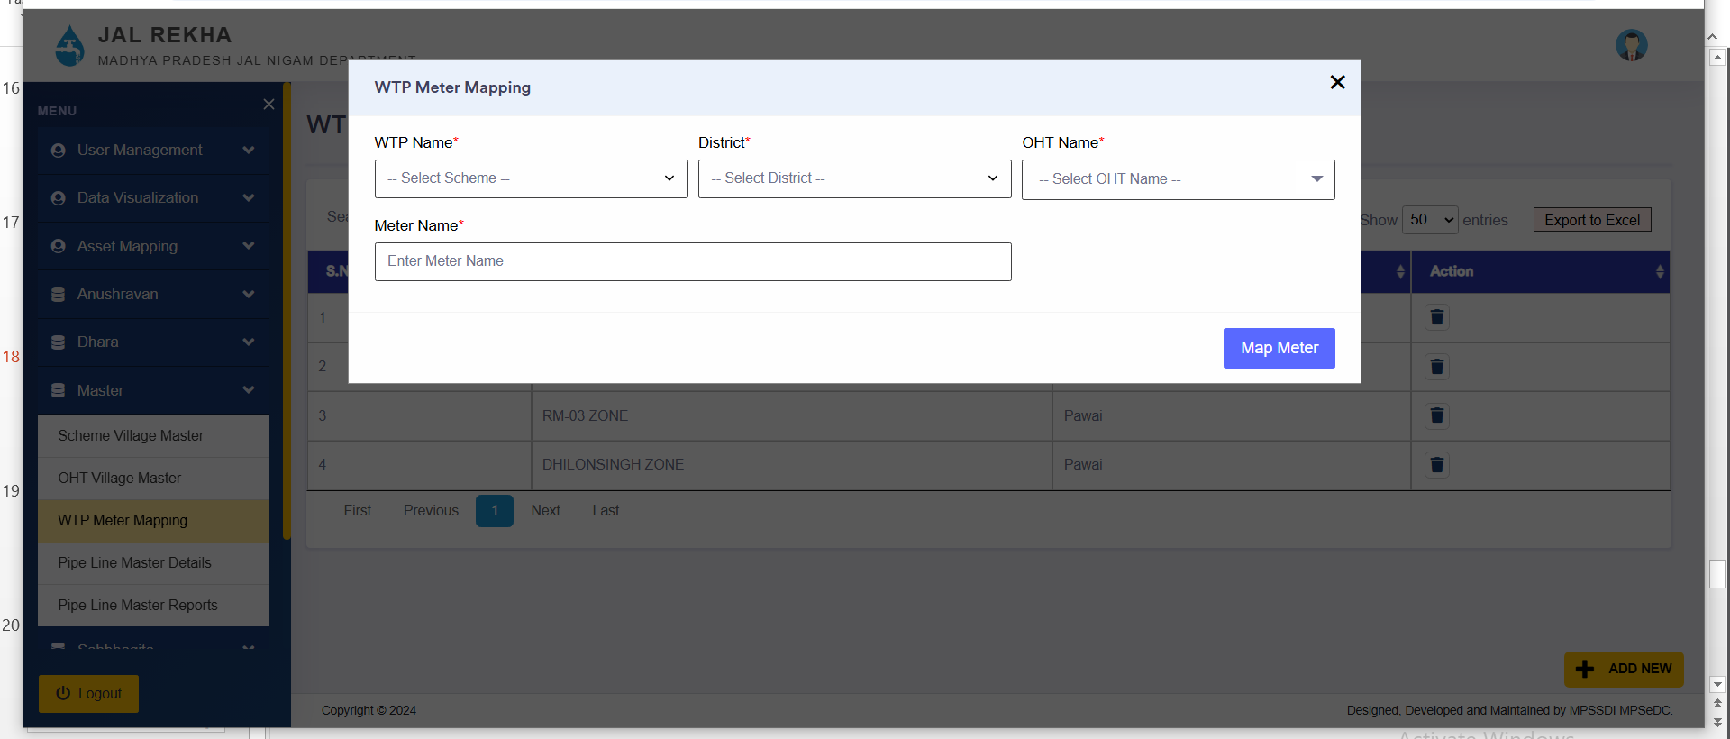
WTP Meter Mapping

Slide 13
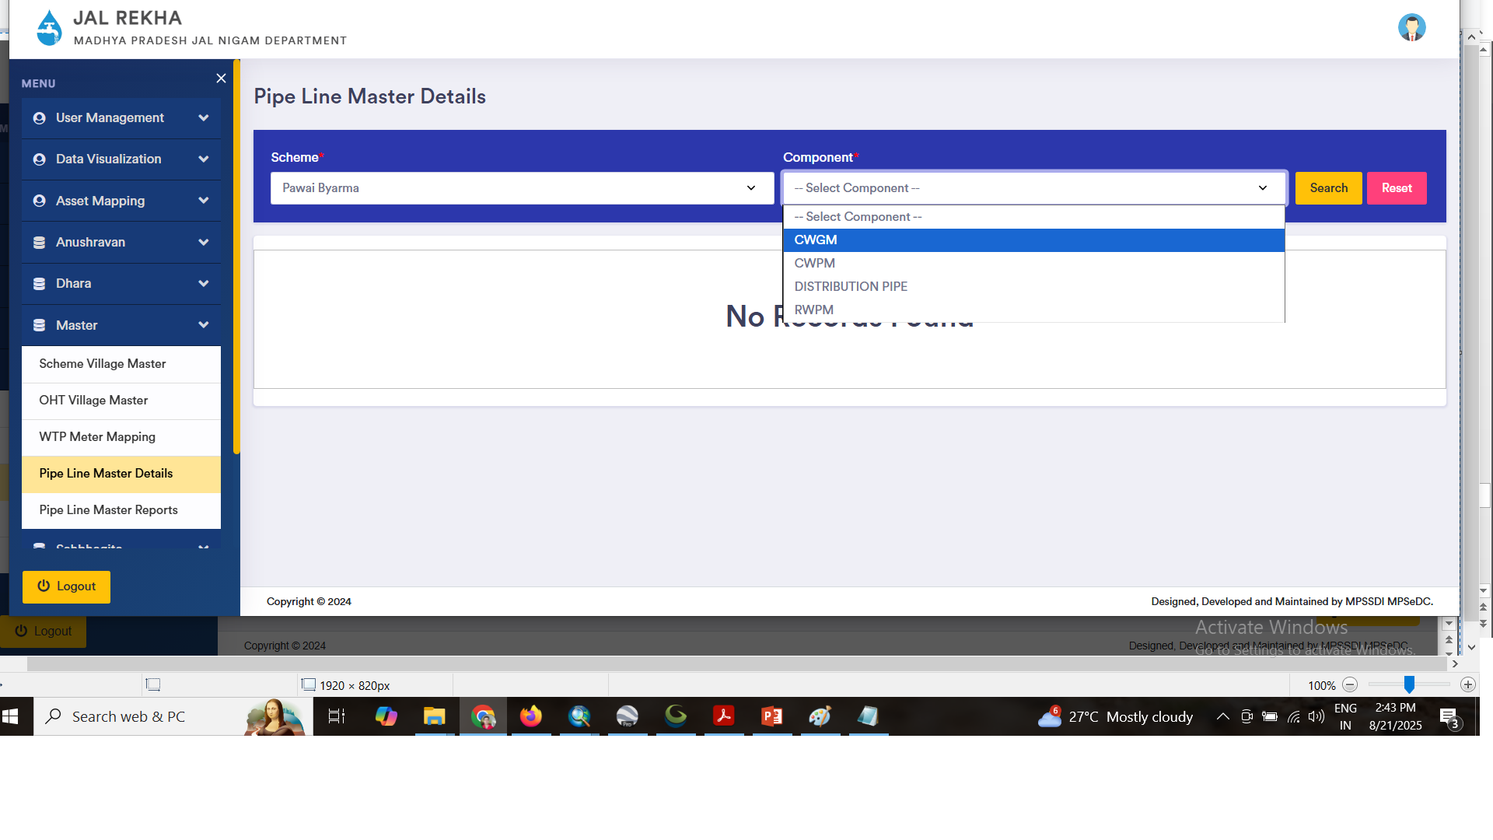
Pipe Line Master

Slide 14
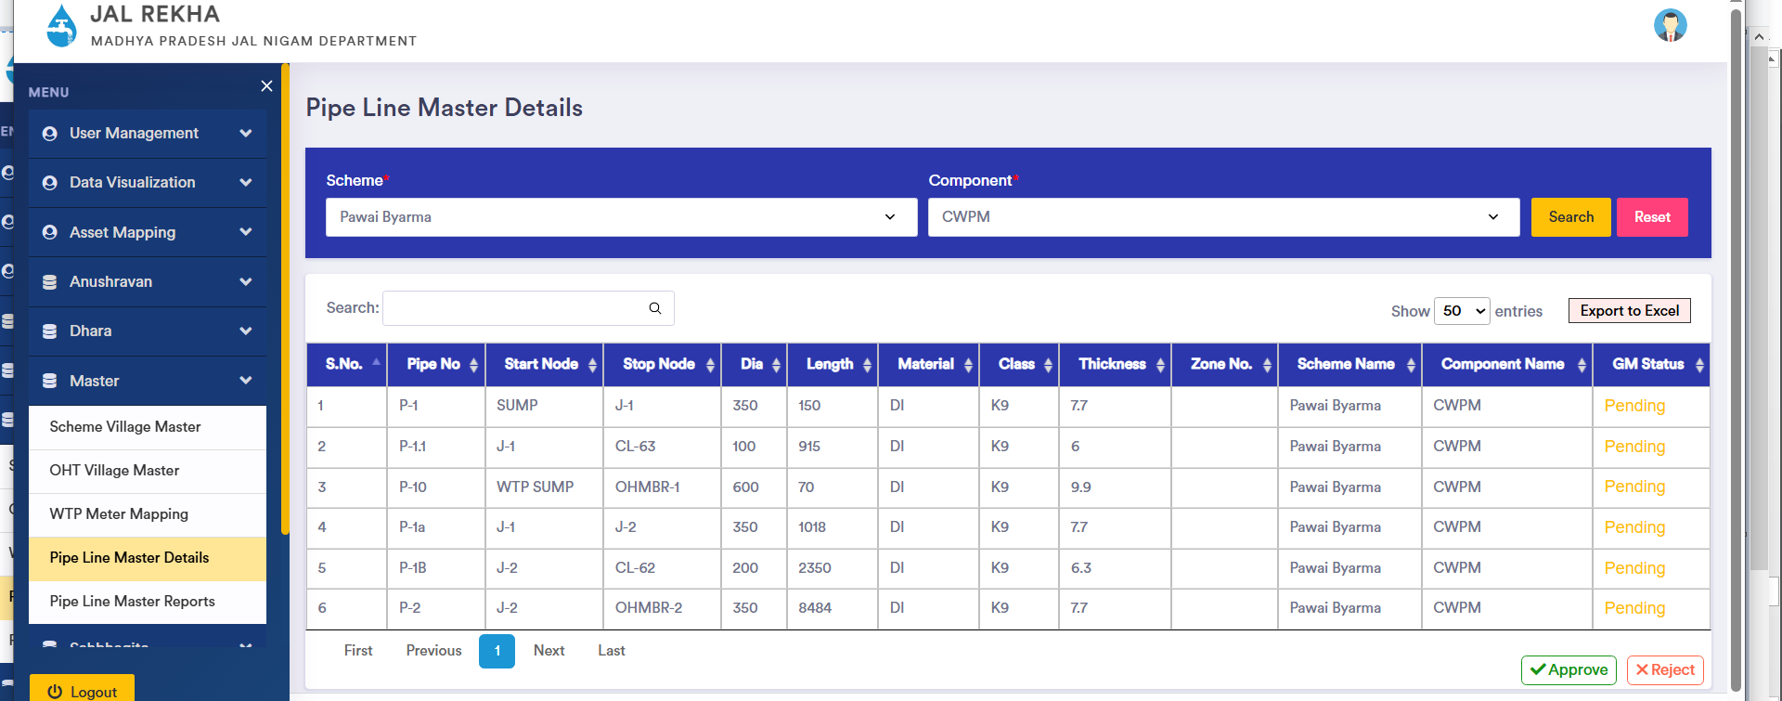

Slide 15
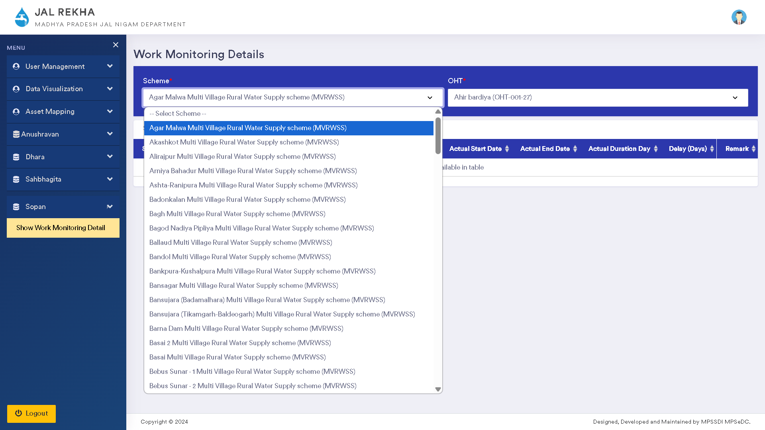
Sopan Module
Sopan Module tracks the stage wise activities performed at the time of implementation of Over Head Tanks.
Key Benefits:
Help in track the actual stage of work completed
Track the delays in Stage wise development
Track the financial liabilities procured at site

Slide 16
Sopan Module
Components
OHT
WTP
Intake well
IPS

Slide 17
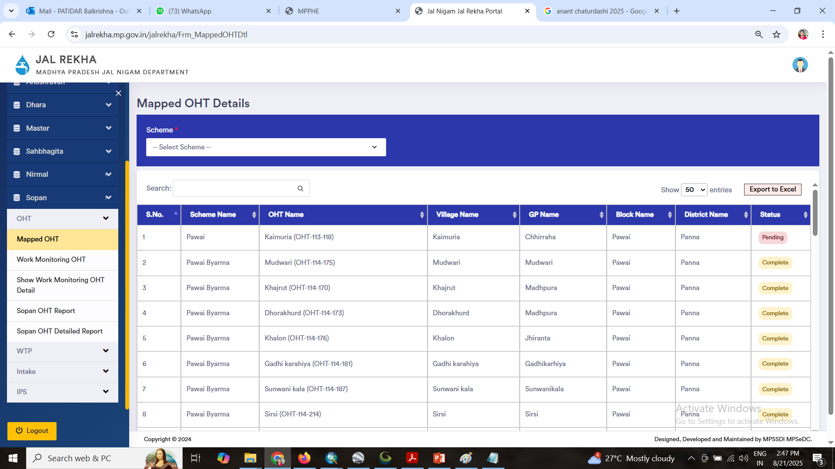
Sopan Module – Mapped OHTs with Scheme

Slide 18
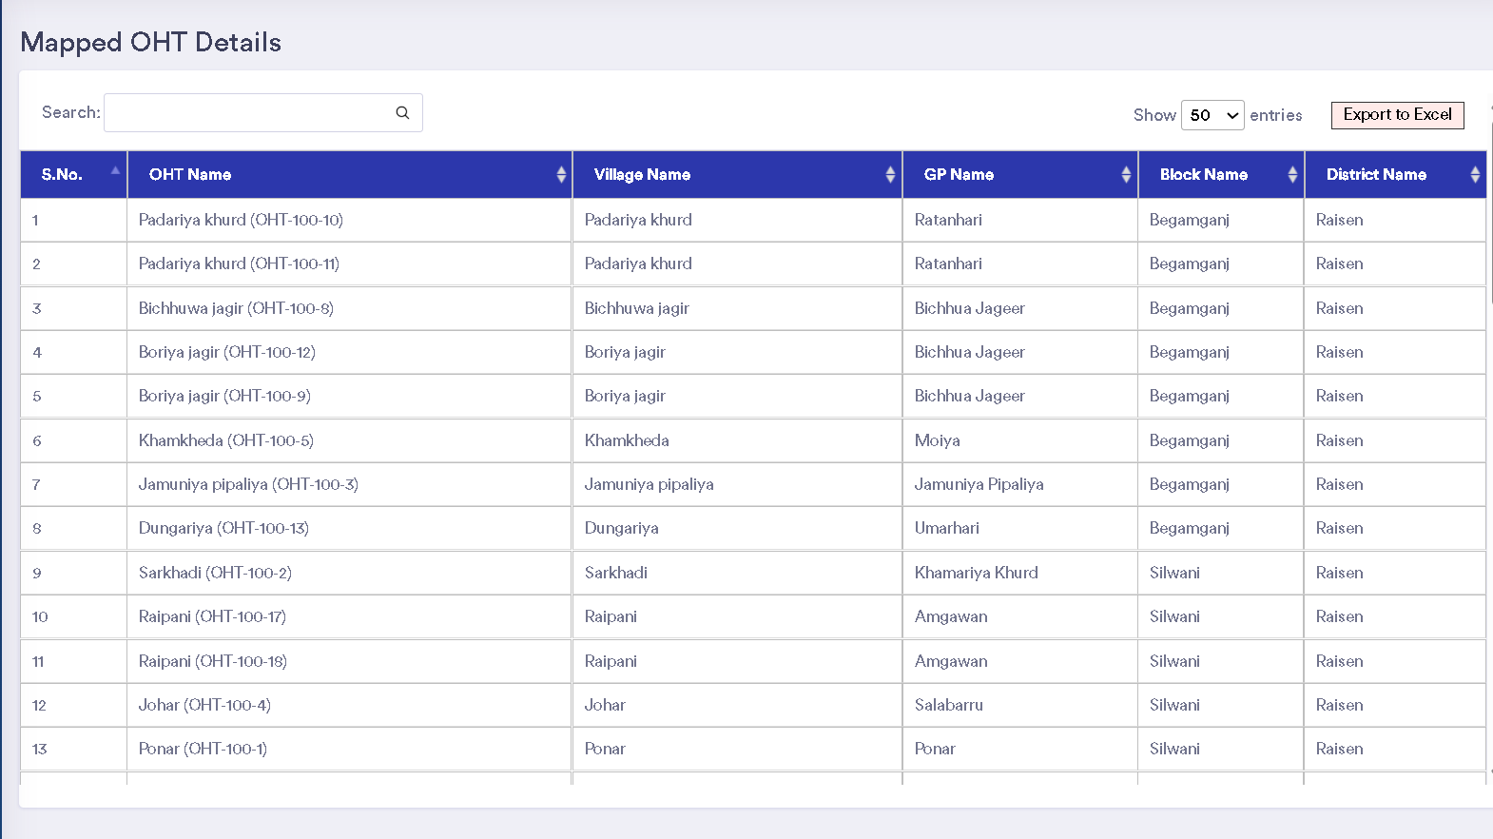
Sopan Module – Mapped OHTs with Scheme

Slide 19
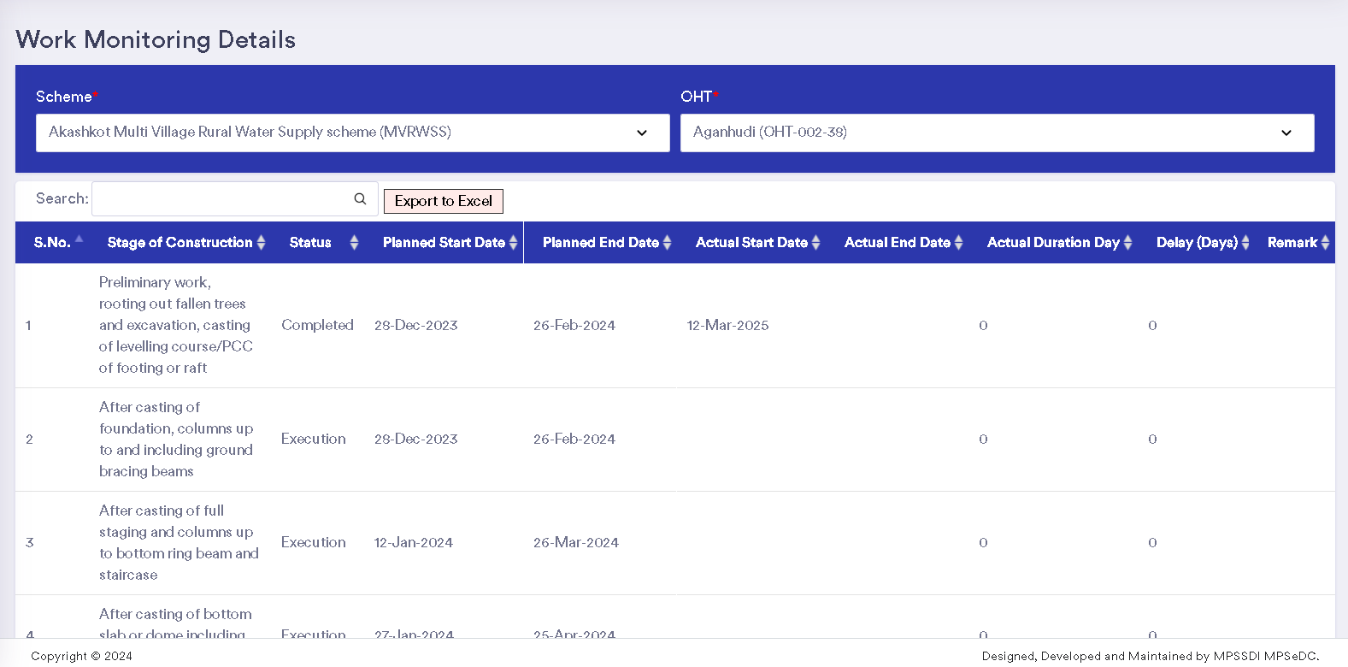
Sopan Module – Details to be Entered

Slide 20
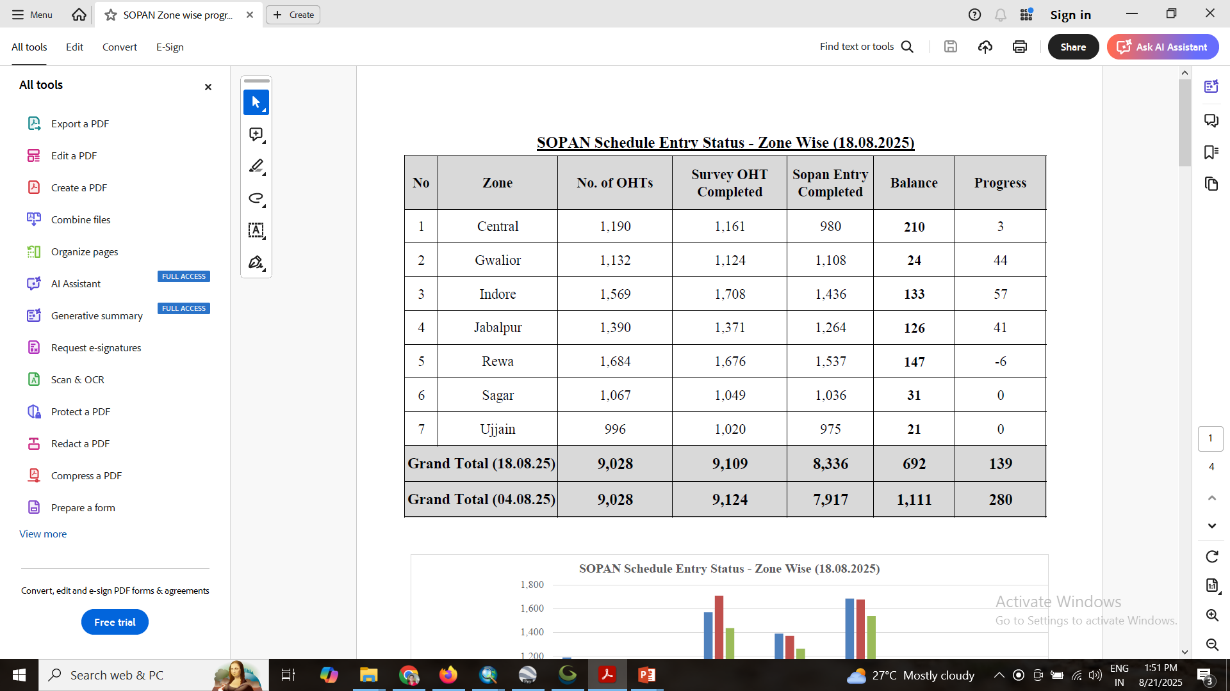
Sopan Module – Reports

Slide 21
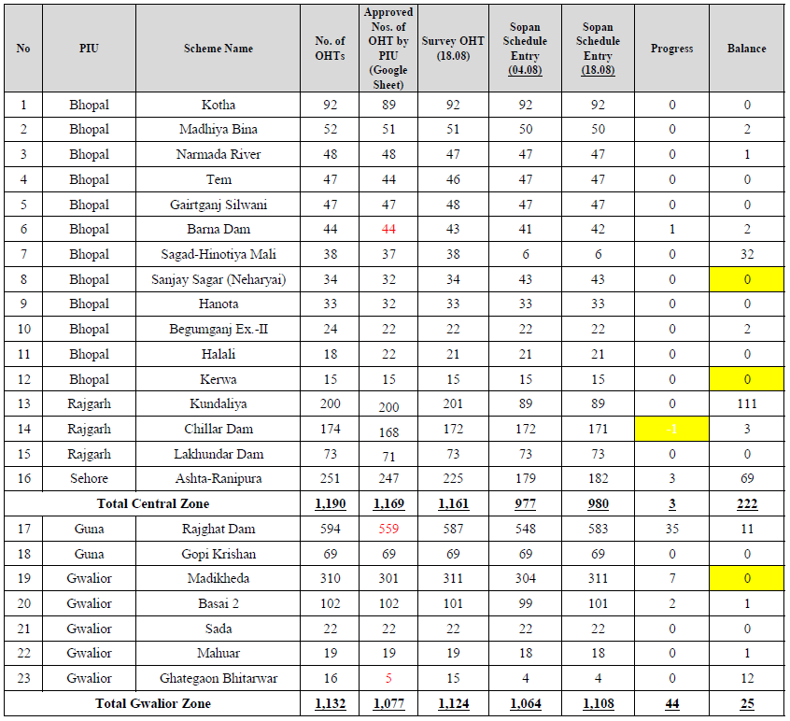
Sopan Module – Reports

Slide 22
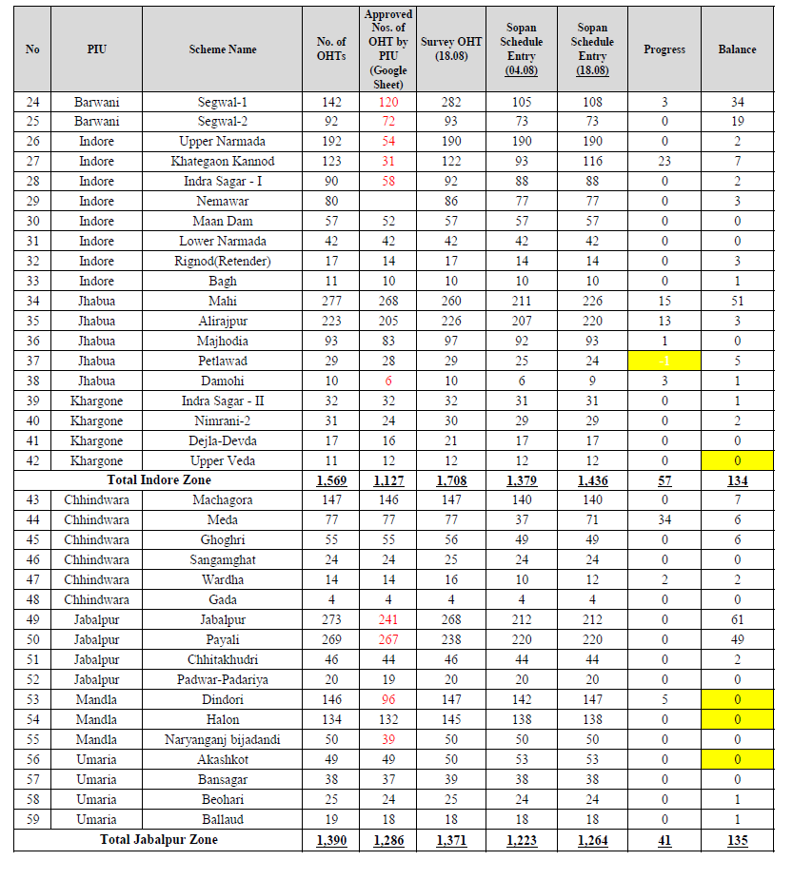
Sopan Module – Reports

Slide 23
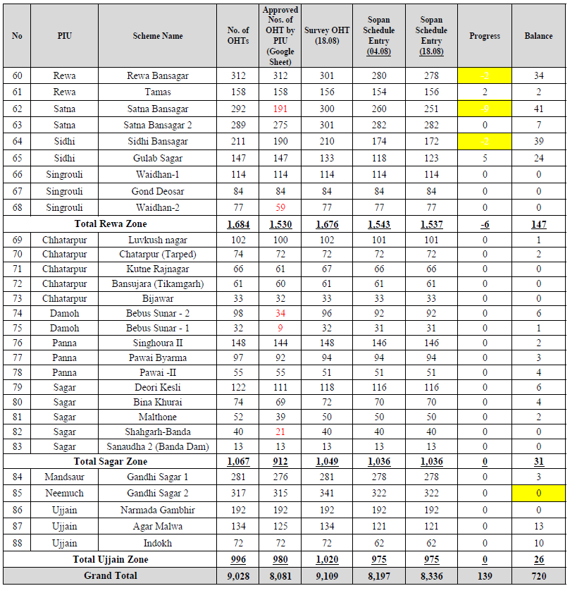
Sopan Module – Reports

Slide 24
Thank you

Slide 25
To view MPJN Water Supply Network on Geoportal
https://jalrekha.mp.gov.in/MPPHE_New/

Slide 26
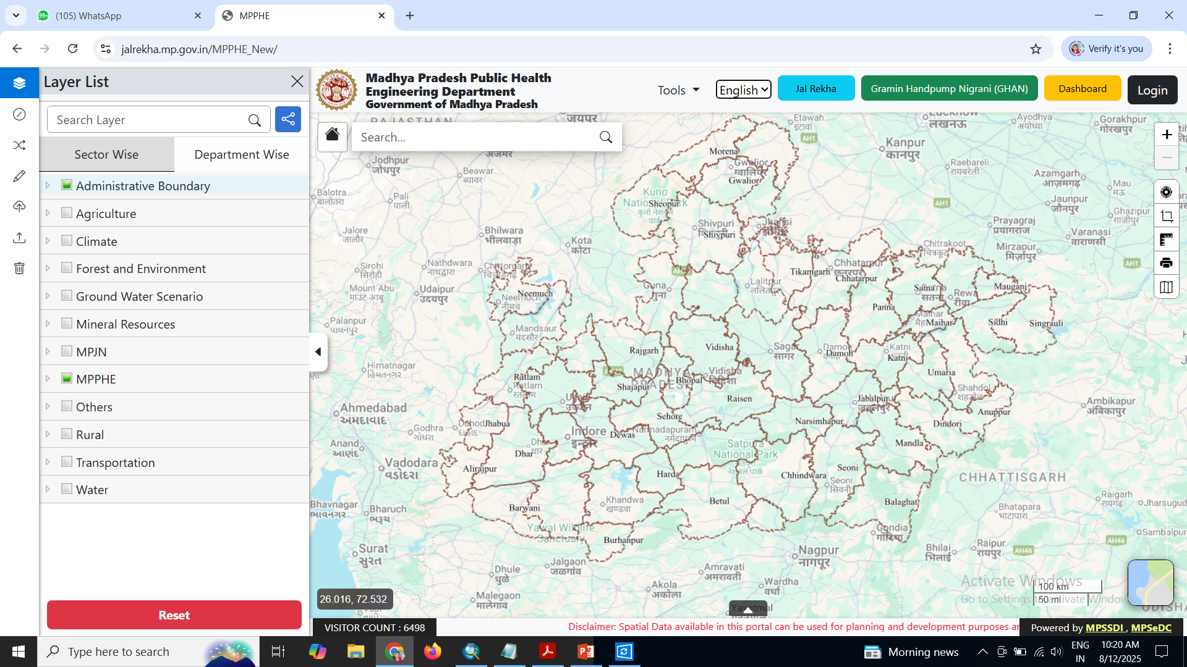
Click on this
Main Geoportal

Slide 27
1. Click on Administrative Boundary and click on check box of Village.
2. Click on MPJN Tab – There are 2 Tab of Design and Drawing & Field Survey Data
3. In both tab layers of water supply components there, click on check box to view. Zoom on particular area to view.

Slide 28
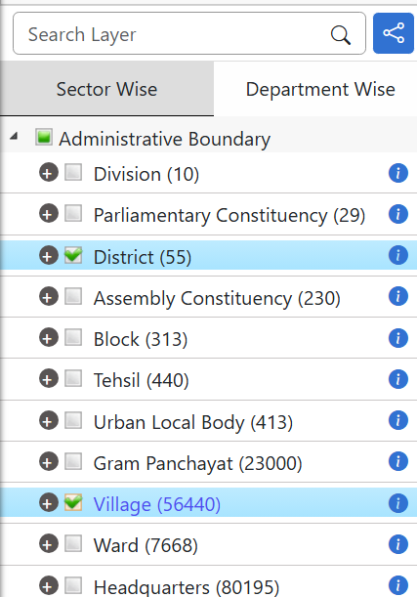
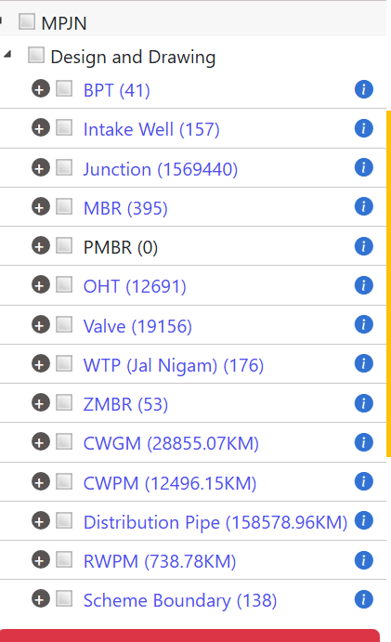
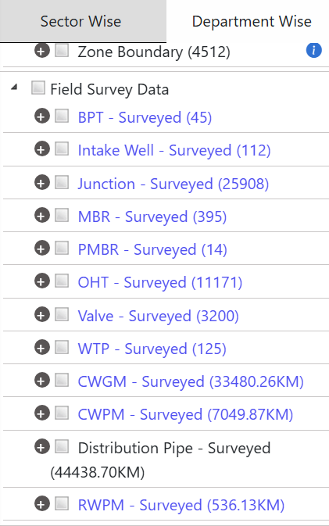

Slide 29
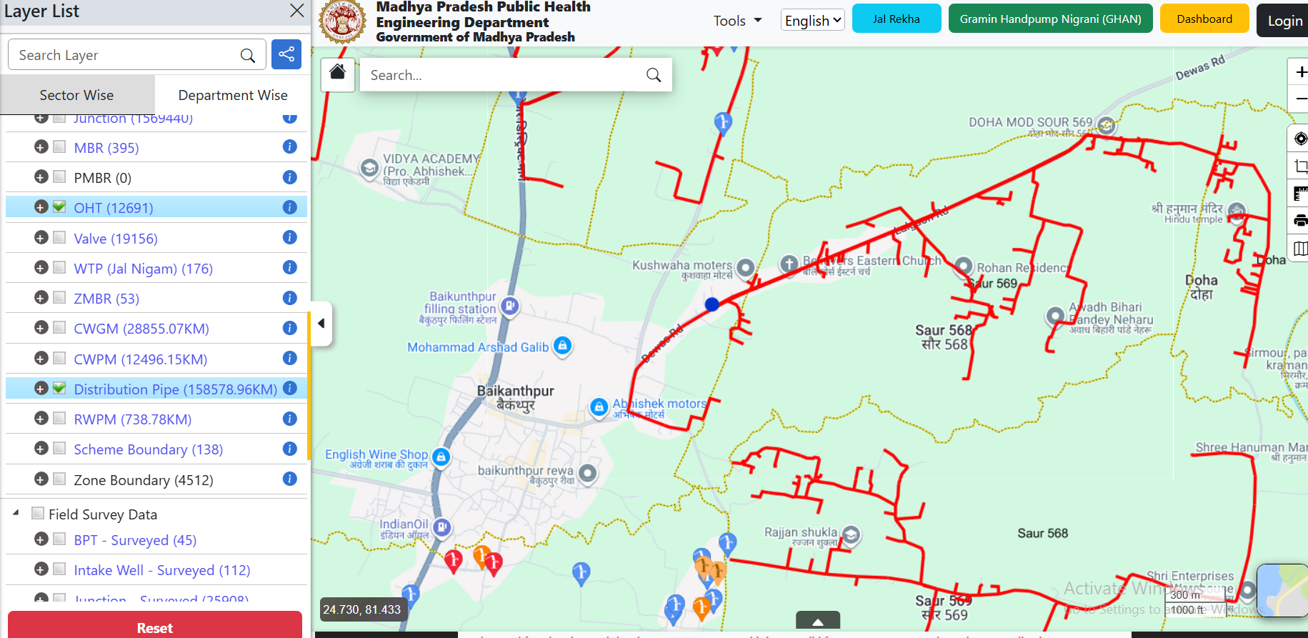
Red line showing Proposed distribution

Slide 30
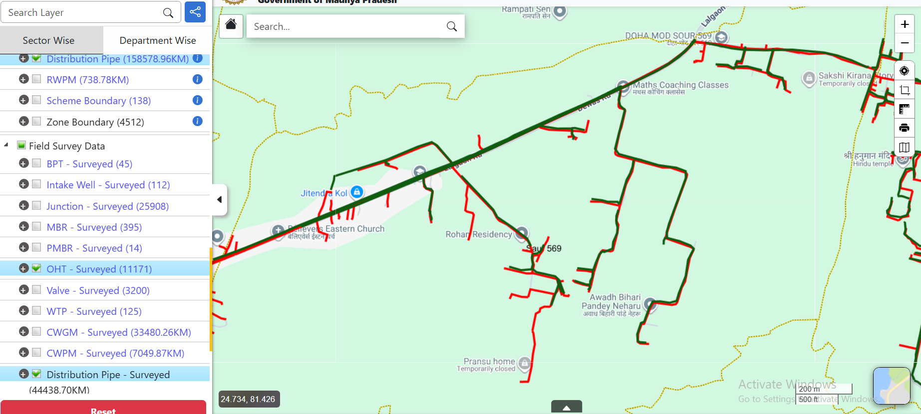
Click on this to layers
on Satellite image
Green line showing Laid Surveyed line (asset mapping using Jal Rekha App)
You can overlay both Proposed & Surveyed line. Click on-off on check box.

Slide 31
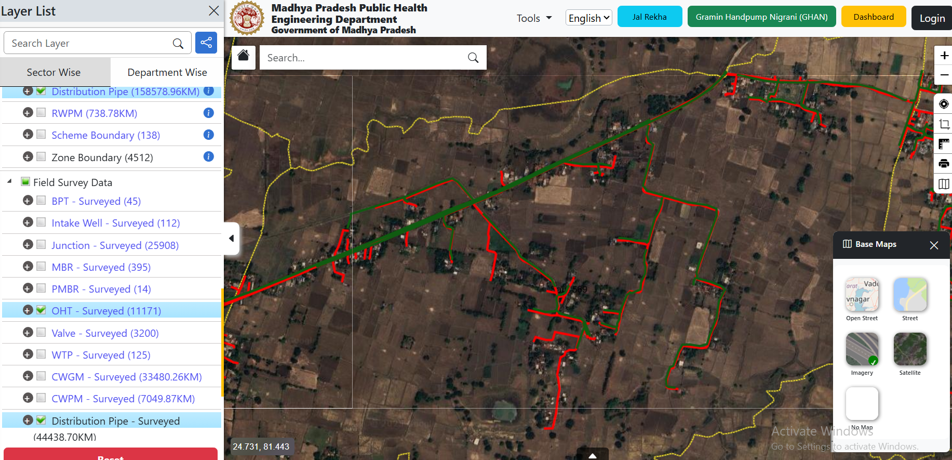

Slide 32
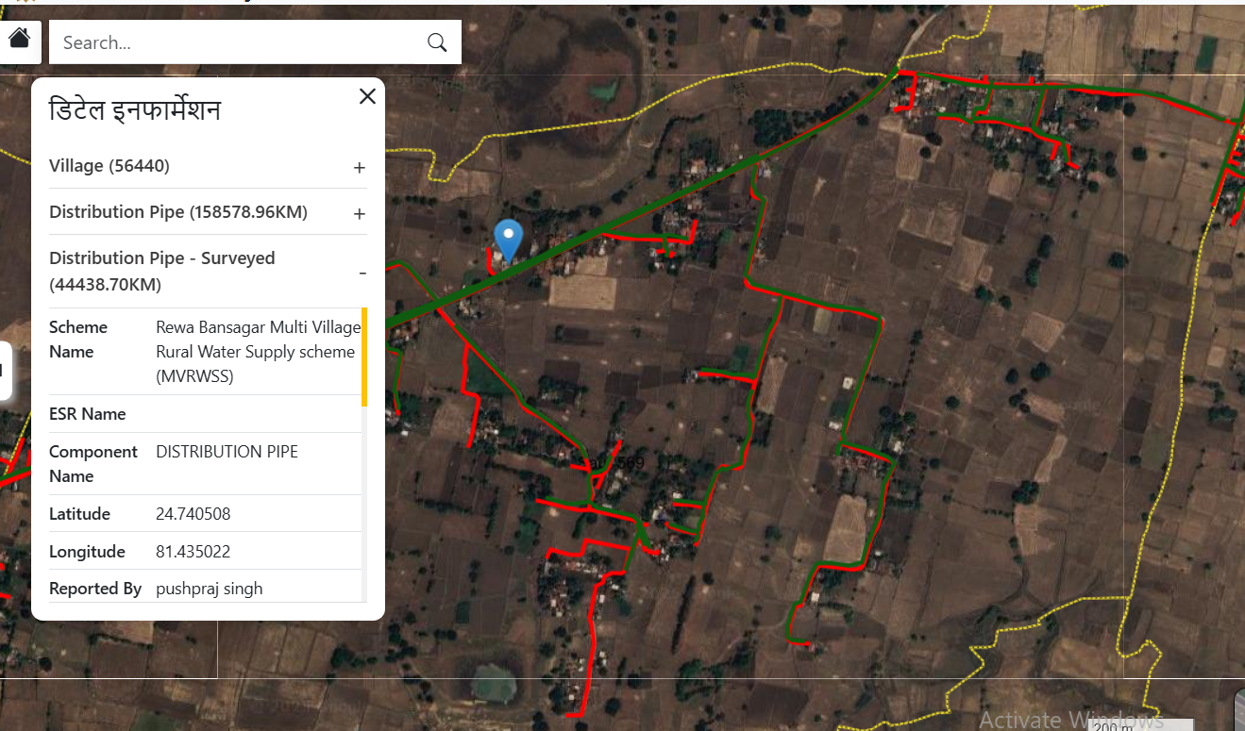
Click on line or point to see attribute detail

Slide 33
Thank you

